Slide 1
Computer Organization and Architecture
Input/output
RIPHAH INTERNATIONAL UNIVERSITY

Slide 2
Input/Output Problems
Wide variety of peripherals
Delivering different amounts of data
At different speeds
In different formats
All slower than CPU and RAM
Need I/O modules
Notes:
An I/O module is not simply a set of mechanical connectors that wire a device into the system bus.
Rather, the I/O module contains logic for performing a communication function
between the peripheral and the bus.

Slide 3
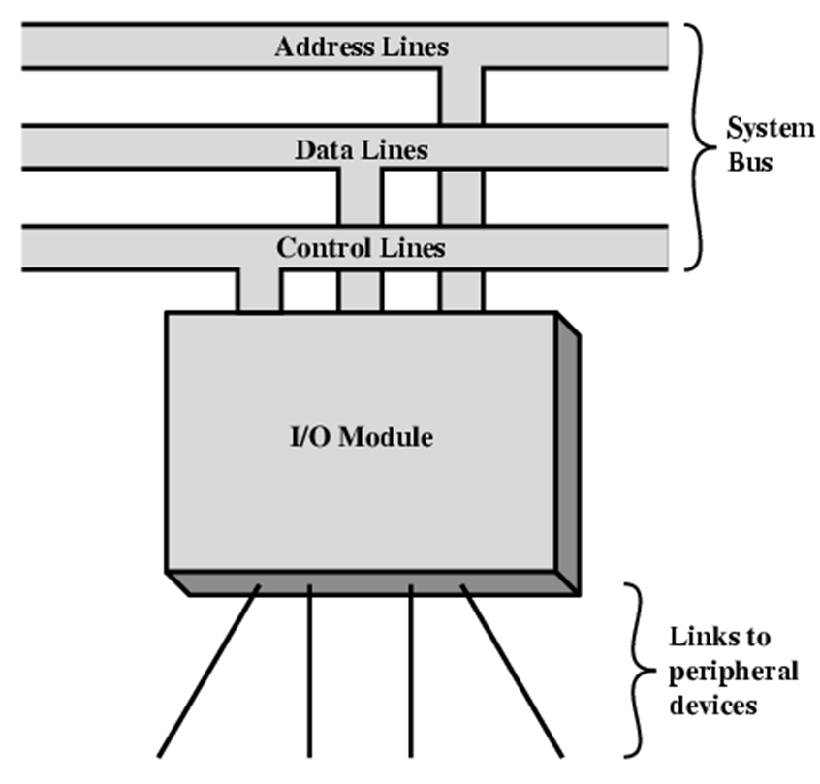
Input/Output Module
Interface to CPU and Memory
Interface to one or more peripherals

Slide 4
External Devices
Human readable
Screen, printer, keyboard
Machine readable
Monitoring and control
Harddrive
Communication
Modem
Network Interface Card (NIC)

Slide 5
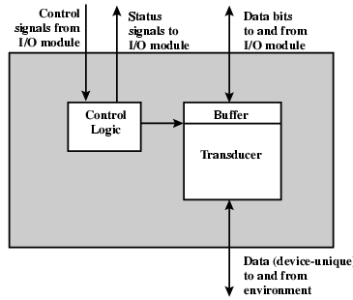
External Device Block Diagram
Notes:
The nature of external device is indicated in diagram. The interface to the I/O module is in the form of control, data, and status signals.
Control signals determine the function that the device will perform, such as
send data to the I/O module (INPUT or READ), accept data from the I/O module
(OUTPUT or WRITE), report status, or perform some control function particular
to the device (e.g., position a disk head). Data are in the form of a set of bits to
be sent to or received from the I/O module. Status signals indicate the state of the
device. Examples are READY/NOT-READY to show whether the device is ready
for data transfer.
Control logic associated with the device controls the device’s operation in
response to direction from the I/O module. The transducer converts data from electrical
to other forms of energy during output and from other forms to electrical during
input. Typically, a buffer is associated with the transducer to temporarily hold data.

Slide 6
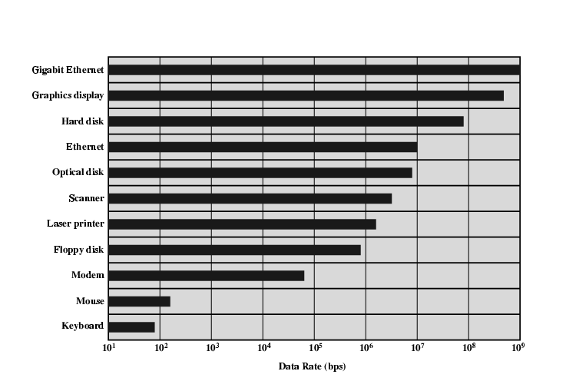
Typical I/O Data Rates
Notes:
Some of the typical devices and their exchange rates.

Slide 7
I/O Module Function
Control & Timing
CPU Communication
Device Communication
Data Buffering
Error Detection
Notes:
The internal resources such as main memory and system bus has to be shared among several activities so control and timing functionality coordinates flow of traffic between system and external devices.
CPU and Device communication involves: Command decoding, Address recognition, Data exchange and Status reporting.
Data buffering to match speed of transfer between devices and CPU.
Finally, an I/O module is often responsible for error detection and for subsequently
reporting errors to the processor. One class of errors includes mechanical
and electrical malfunctions reported by the device (e.g., paper jam, bad disk track).

Slide 8
I/O Module Function
Control & Timing
The I/O module coordinates and controls the timing of data exchange between the CPU and peripherals.
It manages handshaking signals that indicate when data is ready to be sent or received.

Slide 9
I/O Module Function
CPU Communication
Command Decoding: The I/O module interprets signals from the processor, understanding what action (read, write, etc.) needs to be performed.
Status Reporting: It reports the status of the connected devices (e.g., ready, busy, or error).
Data Transfer: The module is responsible for moving data between the processor and the peripheral devices.

Slide 10
I/O Module Function
Device Communication
Signal Conversion: I/O modules convert the signals from peripheral devices to a form that the processor can handle (e.g., converting analog signals from sensors into digital data).
Data Buffering: Since devices often work slower than the processor, the I/O module buffers the data, allowing the CPU to work more efficiently.

Slide 11
I/O Module Function
Data Buffering
When there’s a speed mismatch between the processor and a peripheral device, the I/O module temporarily stores data in a buffer. This prevents the processor from waiting while slower devices complete data transfers.
Error Detection
The module detects and reports errors (e.g., parity errors, device malfunctions i.e. paper jam, bad disk track) during data transfer, allowing the system to take corrective actions.

Slide 12
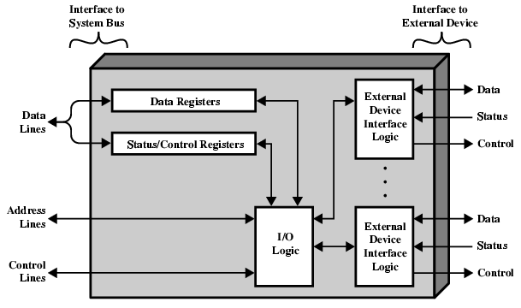
I/O Module Diagram
The processor uses the control lines to issue commands to the I/O module
Each I/O module has a unique address or, a set of addresses.
I/O module contains logic specific to the interface with each device that it controls.
Notes:
Data transferred to and from module is buffered in data registers. Control and staus information is buffered in control registers.

Slide 13
I/O Steps
CPU checks I/O module device status
I/O module returns status
If ready, CPU requests data transfer
I/O module gets data from external device
I/O module transfers data to CPU

Slide 14
Decoding I/O Commands
CPU issues address
Identifies module (& device if >1 per module)
CPU issues command
Control – activates device and tells it what
e.g. spin up disk
Test - check status
e.g. power? Error?
Read/Write
Module transfers data via buffer from/to device
Notes:
Read from device
Control: used to activate a peripheral and tell it what to do. For example, a
magnetic-tape unit may be instructed to rewind or to move forward one record.
These commands are tailored to the particular type of peripheral device.

Slide 15
Data and Status Reporting
Data: Data are exchanged between the processor and the I/O module over the data bus.
Status reporting: peripherals are slow, it is important to know the status of the I/O module.
For example, if an I/O module is asked to send data to the processor (read), it may not be ready to do so because it is still working on the previous I/O command.
reported with a status signal such as BUSY and READY.

Slide 16
Addressing I/O Devices
Each IO related instruction maps to an IO command that processor send to IO module
Processor issues command that has address
Address in command identifies a device
Module interprets command to identify concerned device
Notes:
Isolated vs memory mapped Moris Mano chp 11

Slide 17
Input Output Techniques
Interrupt driven
The I/O module generates interrupt signals to notify the CPU when it’s ready to transfer data or when a task has completed, allowing the CPU to handle I/O asynchronously.
Direct Memory Access (DMA)
For large data transfers, the I/O module may include DMA capabilities, allowing data to move directly between the memory and peripherals without involving the CPU. This increases efficiency, especially for large data operations.

Slide 18
Programmed I/O
CPU has direct control over I/O
Sensing status
Read/write commands
Transferring data
CPU waits for I/O module to complete operation
Wastes CPU time

Slide 19
Programmed I/O - detail
CPU requests I/O operation
I/O module performs operation
I/O module sets status bits
CPU checks status bits periodically(busy waits)
I/O module does not inform CPU directly
I/O module does not interrupt CPU
CPU may wait or come back later
Notes:
the processor is executing a program and encounters an instruction relating
to I/O, it executes that instruction by issuing a command to the appropriate
I/O module.

